Slide 1

uNit 7 – Hardware
Computing Systems

Slide 2
Index
Hardware
Motherboard
Form factor
Chipset
Sockets
Microprocessor
External data bus
Pipeline
Cache
Names and numbering
Memory
Hierarchy
Latence
Recognition
Dual channel
XMP
GPU
Throughput oriented
CUDA
SLI and Crossfire
Audio
Concept
Tools and curves
Comercial Hardware
Network
Disk
Thermal performance
Heat transfers
Guideline in selected fan
Power
ARM case

Slide 3
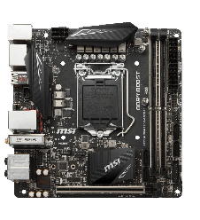
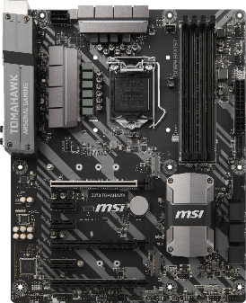
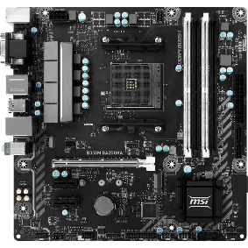
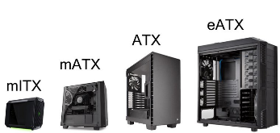
Motherboard
Form Factor
eATX(servers) 30,5 cm x 33 cm
ATX 30,5 cm x 22,4 cm
Mini-ATX 28,4 cm x 20,8 cm
Micro-ATX 24,4 cm x 24,4 cm
Mini-ITX 17 cm x 17 cm
Nano-ITX 12 cm x 12 cm
Pico-ITX 10 cm x 7,2 cm
Mobile-ITX 6 cm x 6 cm
MICRO-ATX
MINI-ATX
ATX

Slide 4
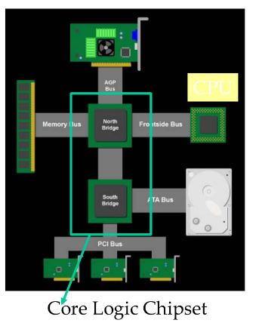
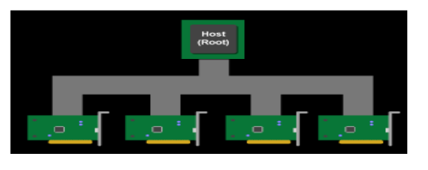
Northbridge
Connects 3 components that must communicate at high speed; CPU, DRAM and Video.
Chipset
Data Flow Management System
Classic PC architecture
Accelerated graphics port AGP 2133 MB/s
Front Side Bus (Core Speed / Multiplier)
Memory Bus (DRAM_ratio:FSB_ratio x FSB_speed)
ATA Bus (166 MB/s)
PCI Bus
Originally 33 MHz, 32-bit wide, 133 MB/s peak transfer rate
More recently 66 MHz, 64-bit, 528 MB/s peak transfer rate
Shared bus with arbitration. Winner becomes bus master and can connect to CPU or DRAM through the Southbridge and Nordbridge.
Southbridge
Serves as a concentrator for slower I/O devices.

Slide 5
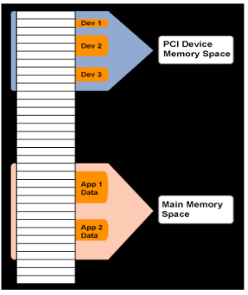
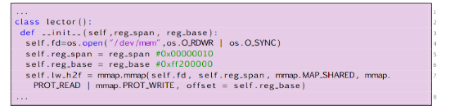
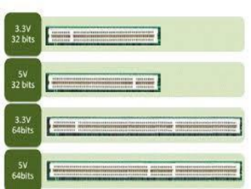
PCI as Memory Mapped I/O
PCI device registers are mapped into the CPU’s physical address space
Accessed through loads/stores (kernel mode)
Addresses are assigned to the PCI devices boot time
All devices listen for their addresses
Python example to read a mapped 32-bits bus.
read_twoBytes=self.lw_h2f.read(2)

Slide 6
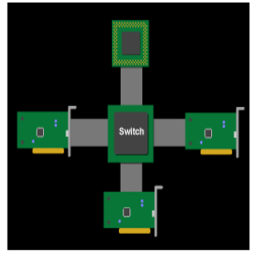
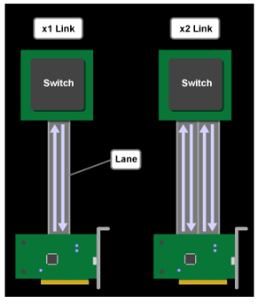
PCI Express (PCIe)
Switched, point-to-point connection
Each card has a dedicated “link” to the central switch, no bus arbitration
Packet switches messages form virtual channel
Prioritized packets for QoS
E.g., real-time video streaming
PCIe 2 Links and Lanes
Each link consists of one or more lanes
Each lane is 1-bit wide (4 wires, each 2-wire pair can transmit 2.5Gb/s in one direction)
Upstream and downstream now simultaneous and symmetric
Each Link can combine 1, 2, 4, 8, 12, 16 lanes- x1, x2, etc.
Each byte data is 8b/10b encoded into 10 bits with equal number of 1’s and 0’s; net data rate 2 Gb/s per lane each way
Thus, the net data rates are 250 MB/s (x1) 500 MB/s (x2), 1GB/s (x4), 2 GB/s (x8), 4 GB/s (x16), each way
8b/10b encoding
Is a line code that maps 8-bit words to 10-bit symbols to achieve DC-balance and bounded disparity, and yet provide enough state changes to allow reasonable clock recovery.
The difference of 1s and 0s in a 20-bit stream should be ≤ 2.
There should be no more than 5 consecutive 1s or 0s in any stream.
00000000, 00000111, 11000001 bad 01010101, 11001100 good

Slide 7
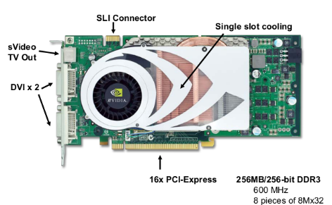
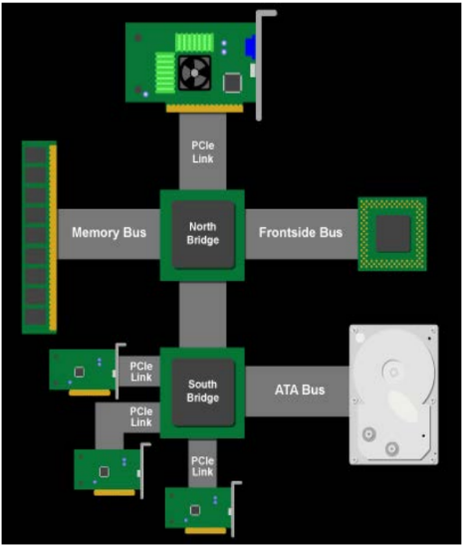
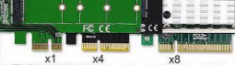
PCIe PC Architecture
PCIe forms the interconnect backbone
Northbridge and Southbridge are both PCIe switches
Some Southbridge designs have built-in PCI-PCIe bridge to allow old PCI cards
Some PCIe I/O cards are PCI cards with a PCI-PCIe bridge
Source: Jon Stokes, PCI Express: An Overview
PCIe 3
4 GT/s in each direction
No more 8/10 encoding but uses a polynomial transformation at the transmitter and its inverse at the receiver to achieve the same effect.
Effective bandwidth is double of PCIe 2

Slide 8
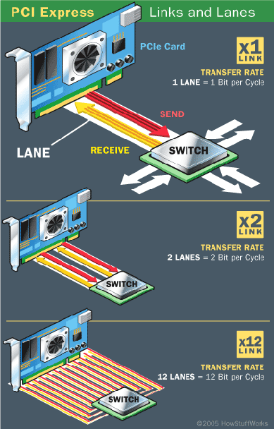
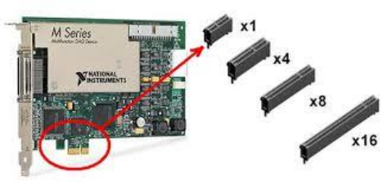
Version | Code | Transfer speed | Bandwidth x Lane
1.0 | 8b/10b | 2.5 GT/s | 2 Gbit/s (250 MB/s)
2.0 | 8b/10b | 5 GT/s | 4 Gbit/s (500 MB/s)
3.0 | 128b/130b | 8 GT/s | 7,9 Gbit/s (984,6 MB/s)
4.0 | 128b/130b | 16 GT/s | 15,8 Gbit/s (1969,2 MB/s)
5.0 | 128b/130b | 32 GT/s | 31,5 Gbit/s (3938,4 MB/s)
6.0 | b / b | GT/s | , Gbit/s (, MB/s)
PCIe
PCIe x1: has 1 lane, 18 pins and 25mm in length.
PCIe x4: Has 4 lanes, 32 pins, and 39mm in length.
PCIe x8: Has 8 lanes, 49 pins, and 56mm in length.
PCIe x16: Has 16 lanes, 82 pins, and 89mm in length.
PCIe x32: Is not used.

Slide 9
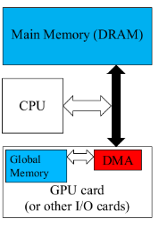
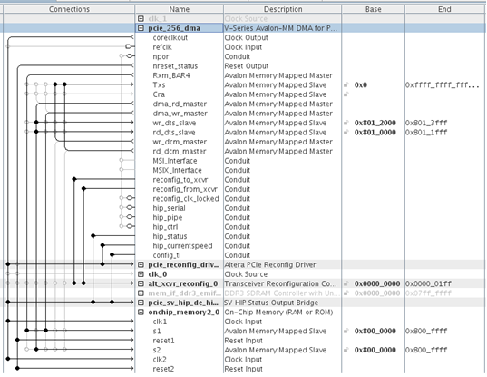
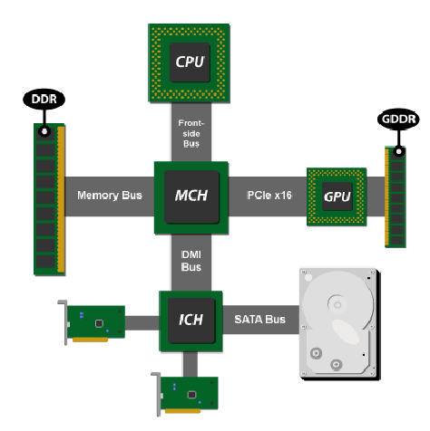
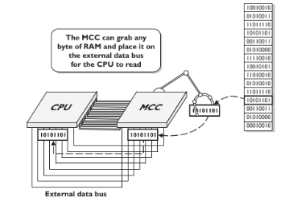
PCIe Data Transfer using DMA (MCC)
DMA (Direct Memory Access) is used to fully utilize the bandwidth of an I/O bus
DMA uses physical address for source and destination.
Transfers a number of bytes requested by OS
Needs pinned memory.
DMA hardware is much faster than CPU software and frees the CPU for other tasks during the data transfer.
Memory controller chip MCC
The MCC contains special circuitry so it can grab the contents of any single line of RAM and place that data or command on the external data bus. This in turn enables the CPU to act on that code

Slide 10
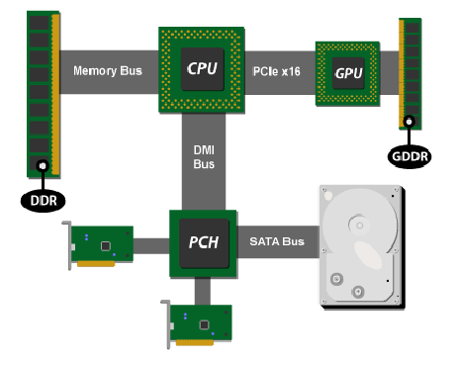
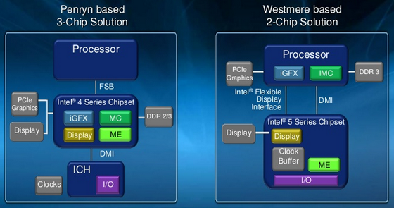
Chipset
Direct media interface P2P.
DMI Bus 3.0 has 4 lanes with 8 GT/s in each lane.
DMI Bus 4.0 has 8 lanes with 16 GT/s in each lane.
Platform controller hub (PCH) integrate Southbridge
Northbridge was deprecated in DMI 2.0
GPU and MMC are integrated in Microprocessor
A new bus, Flexible Display Interface (FDI) appears to communicate the processor to the chipset that has the connectors.
SATA Bus.

Slide 11
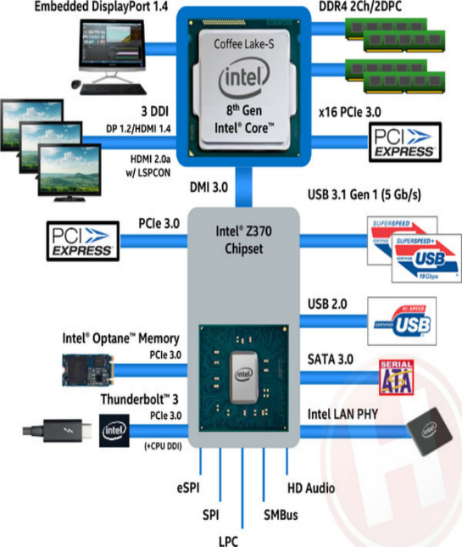
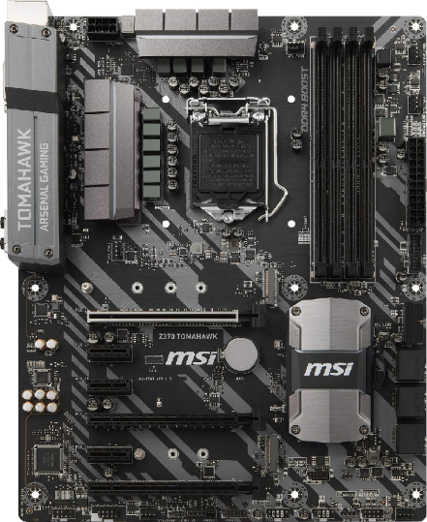

Slide 12
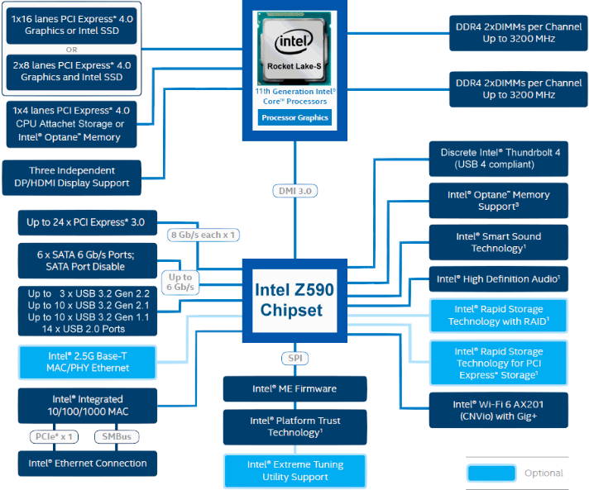
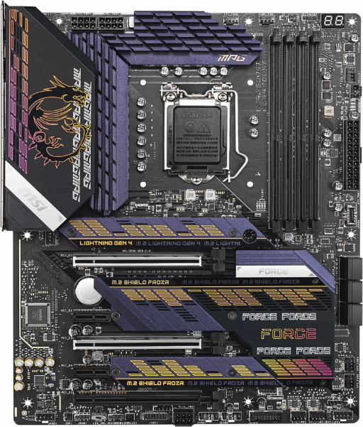

Slide 13
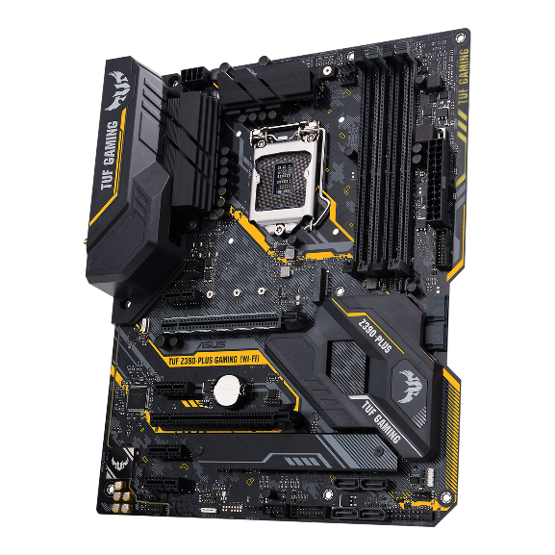
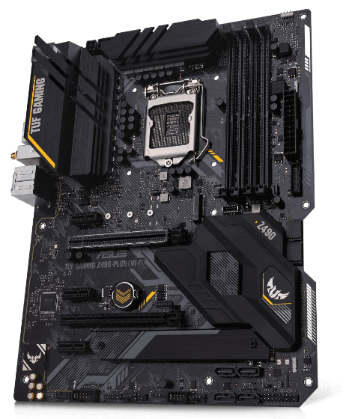
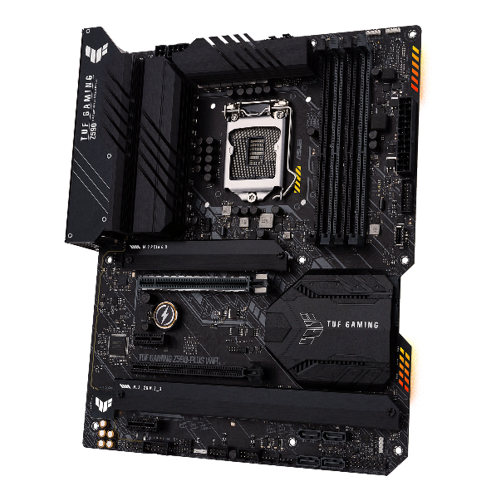
Chipset make a difference

Slide 14
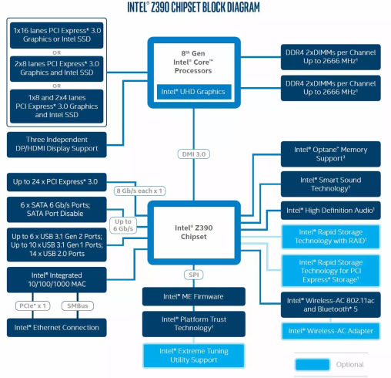
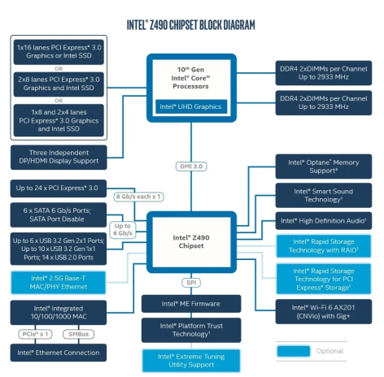

Slide 15
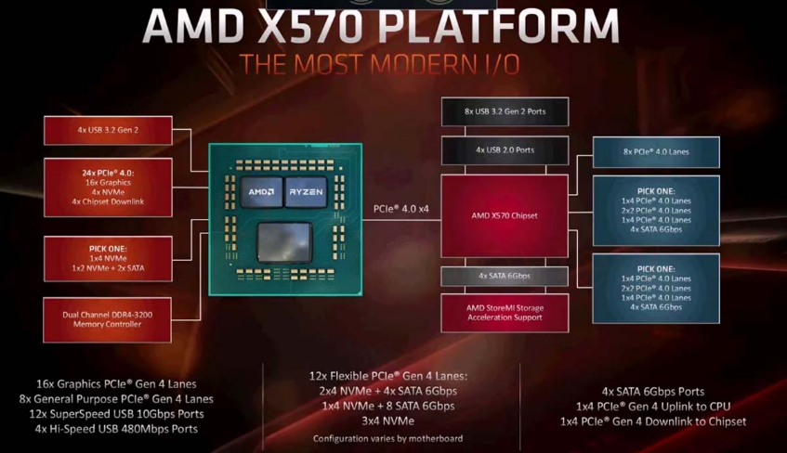
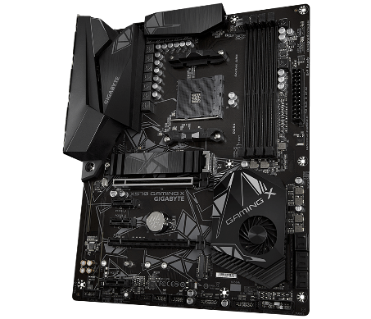

Slide 16
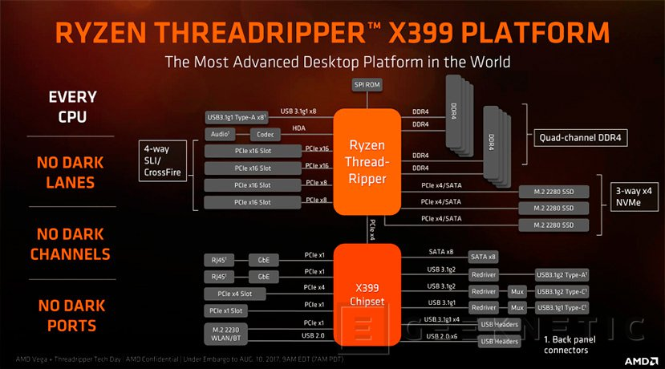
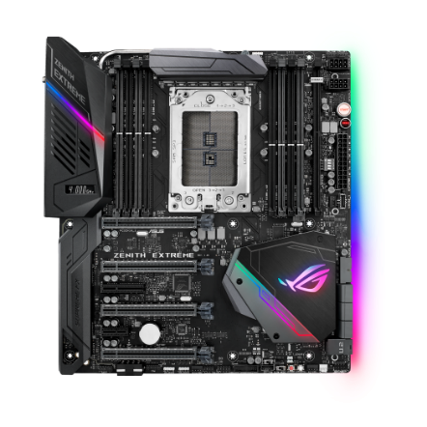

Slide 17
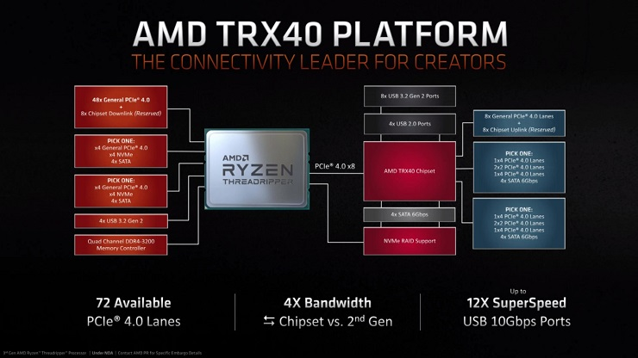

Slide 18
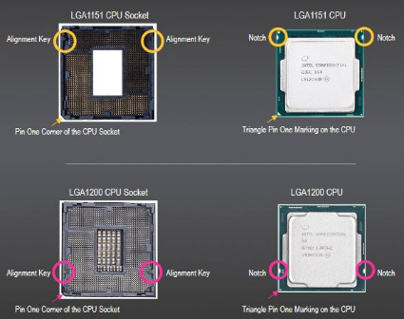
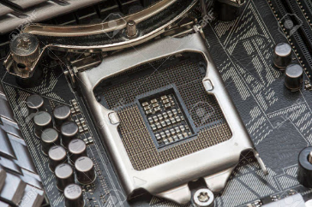
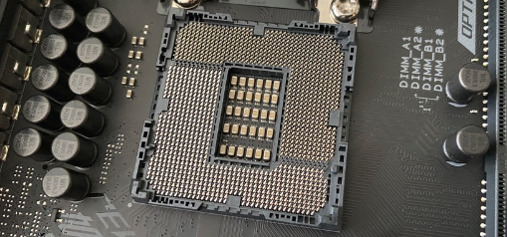
Sockets Intel
LGA 1151 socket H4/ LGA 1200 /LGA 1700
LGA 1366 (socket B) / LGA 2011 (socket R) /LGA 2066
LGA 3647
LGA 1151 V1 Processors:
6a Skylake
7a Kaby Lake
8a 9a Coffee Lake (LGA 1151 V2)
LGA 1200 Processors:
10a Comet Lake
11a Rocket Lake

Slide 19
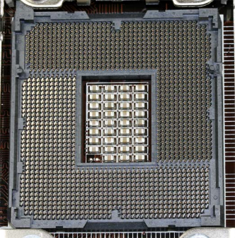
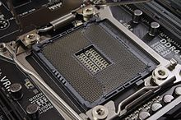
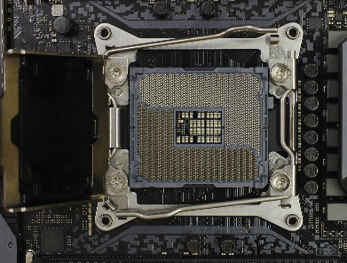
Sockets Intel
LGA 1151 socket H4/ LGA 1200 /LGA 1700
LGA 1366 (socket B) / LGA 2011 (socket R) /LGA 2066
LGA 3647
LGA 2066 Processors:
Kaby Lake-X
Skylake-X
Skylake-W
Cascade Lake-X
Cascade Lake-W
LGA 1366 Processors:
Intel Core i7 (9xx series)
Intel Xeon (35xx, 36xx,
55xx, 56xx series)
LGA 2011 Processors:
Sandy Bridge Core i7 (3xxx series)
Intel Xeon (E5 series)
Ivy Bridge Core i7 (4xxx series)
Haswell Core i7 (5xxx series)

Slide 20
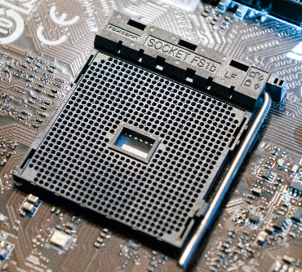
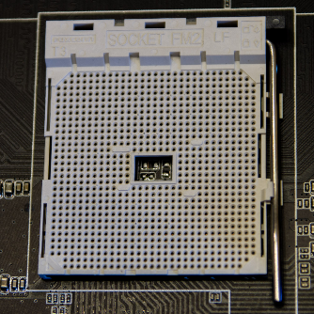
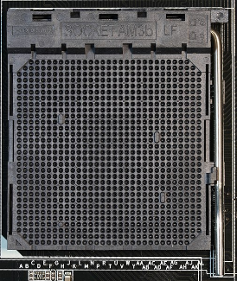
Sockets AMD
PGA FS1b AM1
PGA FM2+
PGA AM3+
PGA AM4
PGA TR4
PGA AM1 Processors:
Athlon 5350, 5150.
Sempron 3859, 2650
PGA FM2+ Processors:
Athlon X2
Athlon X4
PGA AM3+ Processors:
Phenom II
Athlon II
FX
Opteron Serie 3000

Slide 21
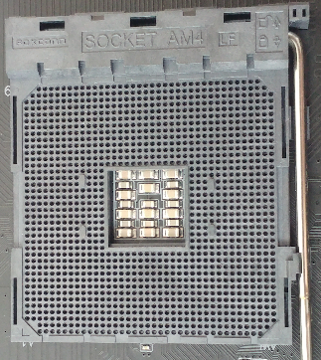
Sockets AMD
PGA FS1b AM1
PGA FM2+
PGA AM3+
PGA AM4
LGA TR4 SP3r2
LGA sTRX4 SP3r3
PGA AM4 Processors:
Ryzen:
Summit Ridge
Raven Ridge
Pinnacle Ridge
Picasso
Matisse
Renoir
Vermeer
Athlon:
Raven Ridge
Picasso
A-Series, Athlon X4:
Bristol Ridge

Slide 22
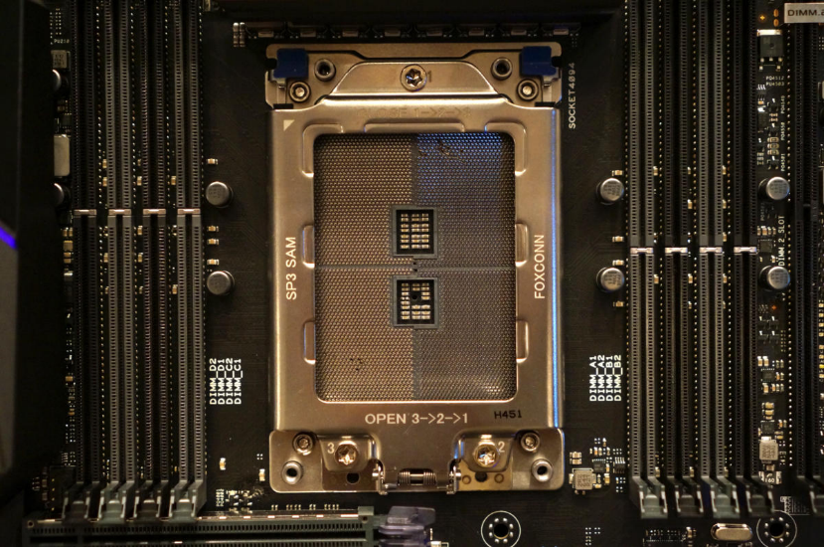
Sockets AMD
PGA FS1b AM1
PGA FM2+
PGA AM3+
PGA AM4
LGA TR4 SP3r2
LGA sTRX4 SP3r3
LGA TR4 Processors:
Ryzen Threadripper:
Whitehaven
Colfax

Slide 23
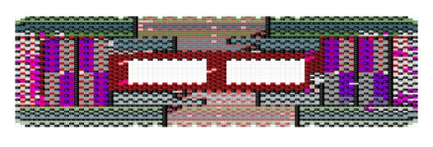
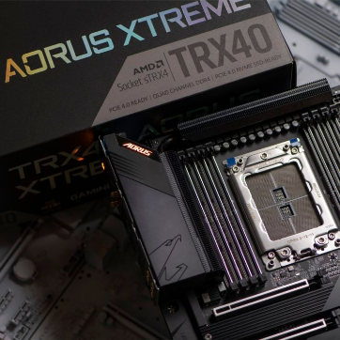
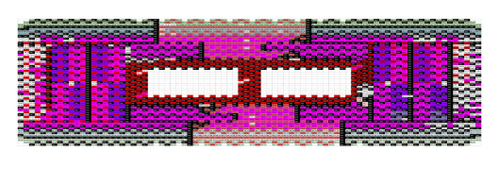
Sockets AMD
PGA FS1b AM1
PGA FM2+
PGA AM3+
PGA AM4
LGA TR4 SP3r2
LGA sTRX4 SP3r3
Same pinout but electrically incompatible
LGA TR4 Processors:
Ryzen Threadripper:
Whitehaven
Colfax
LGA sTRX4 Processors:
Ryzen Threadripper:
Castle Peak

Slide 24



Microprocessor
Imagine the CPU as a man in a box.

Slide 25



Imagine that we install a set of 16 light bulbs, 8 inside his box and 8 outside his box.
Each of the 8 light bulbs inside the box connects to one of the 8 bulbs outside the box to form a pair.
Each pair of light bulbs is always either on(1) or off(0). You can control the 8 pairs of bulbs by using a set of 8 switches outside the box, and the Man in the Box can also control them by using an identical set of 8 switches inside the box.
This light bulb communication device is called the external data bus (EDB)

Slide 26


Pipeline
Fetch: Get the data from the EDB.
Decode: Figure out what type of command needs to be done.
Execute: Perform the calculation.
Write: Send the data back onto the EDB.
The two pipelines on the old Pentium were so successful that Intel and AMD added more and more pipelines to subsequent CPUs.

Slide 27


Slide 28



HyperTransport (HT)
Also known as Lightning Data Transport (LDT) is a bi-directional communications technology, which works both serially and in parallel, and offering high bandwidth in point-to-point connections with low latency. It is the one used by AMD and offers an advanced high speed and high bus performance, was published on April 2, 2001. It was designed with the intention of decreasing the number of buses.
QuickPath (QPI)
The Intel QuickPath Interconnect is a point-to-point connection point with the processor developed by Intel to compete with HyperTransport, was released by Intel in November 2008 on its Intel Core i7 processor family and on the X58 chipset, and is used in the Nehalem, and Sandy Bridge processors. Among others.

Slide 29


Cache memory
MCC
Such like AMD's HyperTransport, the QuickPath Architecture assumes that the processor has a built-in memory controller, thus forcing multiprocessors to use a NUMA (Non-Uniform Memory Access), offering distributed memory for each processor, thus avoiding affecting the performance of the system when several processors trying to access the same memory.

Slide 30




Names, numbers and generation
Suffix | Meaning
K | Unlocked
G | Includes discrete graphics on package
 | i3 | i5 | i7 | i9
Cores | 4 | 6 | 8 | 8
Threads | 8 | 12 | 16 | 16

Slide 31

Names, numbers and generation
AMD FX high-performance CPUs
FX is the name for AMD’s high-end processors.
No built-in graphics chip.
The first number provides the number of cores the CPU.
FX-8XXX (8 cores), FX-6XXX (6 cores), FX-4XXX (4 cores).
The second number indicates the generation
FX-81XX (1st generation) – FX-82XX (2nd generation).
The last number indicates performance level within that chip class.
Higher and lower performance level respectively:
FX-8350 & FX-8320 – FX-6350 & FX-6300 – FX-4350 & FX-4300.

Slide 32

Names, numbers and generation
First Generation: 14nm Zen released in March of 2017
Second Generation: 12nm Zen+ released in April of 2018
Third Generation: 7nm Zen 2 released in July of 2019
Fourth Generation: 7nm Zen 3 released in November 2020
For AMD mainstream desktop CPUs, the SKU naming goes like this:
First Generation Zen: Ryzen 1000 Series “Summit Ridge”
Example: Ryzen 7 1800X
Second Generation Zen+: Ryzen 2000 Series “Pinnacle Ridge”
Example: Ryzen 7 2700X
Third Generation Zen 2: Ryzen 3000 Series “Matisse”
Example: Ryzen 7 3700X
Fourth Generation Zen 3: Ryzen 5000 Series “Vermeer”
Example: Ryzen 9 5900X

Slide 33

Names, numbers and generation

Slide 34

Memory
Hierarchy

Slide 35
Latency
Intel i7-8700 @ 3,2 Ghz. 12MB L3, 256kB L2, 32+32kB L1
L1: 60%; 1.25 ns
L2: 80%; 3.125 ns
L3: 98,2%; 12.5 ns
RAM:100%; 50 ns
tm= tc*Pa+(1-Pa)*tf
tm= 0,6 * 1,25 + 0,4 * [0,8 * 3,125 + 0,2 * (0,988 * 12,5 + 0,018 * 50)] = 2,786 ns
yes
0,6
L1
0,8
yes
no
L2
yes
0,982
no
L3
no
RAM

Slide 36




Recognition

Slide 37




Technology | MHz Speed(Data Rate) | Module Classification | Module Peak Bandwidth
DDR3 (1.5V) DDR3L (1.35V) | 800 (DDR3-800) | PC3-6400 | 6.4 GB/sec.
 | 1066 (DDR3-1066) | PC3-8500 PCL-8500 | 8.5 GB/sec.
 | 1333 (DDR3-1333) | PC3-10600 PC3L-10600 | 10600 MB/sec.
 | 1600 (DDR3-1600) | PC3-12800 | 12800 MB/sec.
 | 1866 (DDR3-1866) | PC3-14900 | 14900 MB/sec.

Slide 38




Dual channel
$ sudo dmidecode --type 17
$ sudo lshw -class memory

Slide 39



Slide 40





Slide 41




GPU
Throughput Oriented Design
Small caches
To boost memory throughput
Simple control
No branch prediction
No data forwarding
GPU
– Energy efficient ALUs
Many, long latency but heavily
pipelined for high throughput
– Require massive number of threads to tolerate latencies
Threading logic
Thread state
– GPUs for parallel parts where throughput wins.
– GPUs can be 10X+ faster than CPUs for parallel code.
– CPUs for sequential parts where latency matters.
– CPUs can be 10X+ faster than GPUs for sequential code.

Slide 42




CUDA
An acronym for Compute Unified Device Architecture, CUDA is a parallel computing platform and application programming interface (API) model created by Nvidia.
mykernel<<<1,1>>>();
• Kernel: a C function which is flagged to be run on a GPU (or a device).
• Triple angle brackets mark a call from host code to device code. Also called a “kernel launch”
kernel_routine<<<gridDim, blockDim>>>(args);

Slide 43






Scalable Link Interface ( SLI ) and Crossfire

Slide 44






Slide 45


AUDIO
Sound levels
The acoustic pressures at which it is sensitive the human ear varies by a huge interval. The acoustic pressure minimal that causes a sensation hearing is 20μ Pa and the threshold maximum is around 20 Pa. The manipulation of values ​​that open such a vast field it is not comfortable, so the use of lization of another scale, logarithmic, and another unit, the decibel (dB).
Concept
What is a decibel (dB)?
It is a dimensionless factor that expresses a relationship between two magnitudes of the same type in logarithmic form.
Sound pressure level:

Slide 46




Tool Tone generator
Tools and curves
https://www.youtube.com/watch?v=qNf9nzvnd1k

Slide 47





c=340 m/s at 15⁰C
100 Hz – 3.4 m
500 Hz – 0.68 m
1 kHz – 34 cm
2.5 kHz – 13.6 cm
B needs to be delayed
@Bob McCarthy

Slide 48







Commercial hardware
Mini HDMI
Phantom 48V

Slide 49







Network
Bonding, Servers or both.
Bonding
Mode 0 | Balance Round-Robin
Mode 1 | Active-Backup. Provides fault tolerance
Mode 2 | Balance Xor. Load Balancing and fault tolerance
Mode 3 | Broadcast
Mode 4 | 802.3ad (Trunking) Dynamic link aggregation. (If switch allows).
Mode 5 | Balance tlb. Adaptative transmit load balancing

Slide 50








Disk

Slide 51

Thermal performance.
Heat’s concept is energy in transit. By contrast temperature is the measure of the average energy. If we add heat to a body it increases its temperature.
In the same way, when the water evaporates, it takes away heat, which lowers its temperature. If the fire is kept it will continue to boil for a while water is left in the pot.
Iceberg and cigarette
A cigarette has a very high temperature. Surely if you touch the tip you get a first degree burn. But you don't have much heat as it would not be able to boil a glass of water. An iceberg has very low temperature but if we manage to extract the heat enough that it would lower it by only one degree we would have the heat necessary to raise the temperature of the glass by many thousands of degrees.
The heat moves from a hot body to a hotest in three basic forms of heat transfer; Driving, Radiation or Convection.
Chapter adapted from Heat and mass transfer: fundamentals and applications, cap.15, Çengel, Yunus A

Slide 52




Material | W / (mK)
Air | 0.027
Tile | 0.6-1
Glass | 1
Silicone | 1.25
Aluminum | 175
Gold | 315
Copper | 360
Silver | 406
Acer | 50
Brass | 109
Plastic | 0.1-0.4
FR4 | 0.25-0.3
Driving
The electronic circuits are printed on pressed copper and bakelite plates known as PCBs (Printed Circuit Board). The most common material used is known as FR4. If an electronic component, such as an SMD (Surface Mounted Device) chip, is soldier on top of it will dissipate heat on it by the phenomenon of conduction.
The heat flux (J / s, Watts) through a material of thickness t, surface A and thermal conductivity k, is directly proportional to the temperature difference between the ends of it. It is understood that the PCB conducts heat mainly transversely. From the table of thermal conductivity of the different materials it can be seen that Silicone has a very low coefficient compared to Silver. The thermal pastes used to assemble the microprocessors are a mixture of silicone and silver adhesive.

Slide 53


Radiation
Emissivity coefficient
Polished metals have very low ε (<0.1). Rusty metals with rough finishes can reach values ​​of 0.5. In the case of iron and steel, it can reach 0.98. Opaque plastics have very high values ​​(0.95). The wood has high values ​​(0.8-0.9). Water, glass and cement have a value of 0.95. Different paints move in the 0.35-0.95 range. Remember to mount the most powerful elements at the ends of cabinets near the chassis.
All bodies emit electromagnetic waves. The intensity depends on the wavelength and temperature. The higher the temperature plus emission. Within the visible spectrum this phenomenon can be observed because it manifests itself in the form of light. However there are many examples of uses of the invisible spectrum. Below 400nm we have nuclear radiation, x-rays and UV rays and so on above 700nm infrared and television and radio waves.
When the environment is at a lower temperature than the heat dissipating equipment, it is transferred to the environment. The power is determined by the emissivity coefficient (ε), a constant (σ), the area and the surface temperature of the object with respect to the ambient temperature (there is also a coefficient with respect to the area that we will estimate as 1).

Slide 54


An ATX box of 230x467x483 mm where the front is ABS and the rest painted metal. We could estimate the heat flow it could dissipate the box by radiation. Assumptions:
The box is placed vertically without any obstacles or walls around it.
The ambient temperature is 40ºC (Extreme enough).
The power of the source is 700W so we assume that this is the maximum power of the equipment.
The lower and front faces do not dissipate heat by radiation (Not true).
We do not know the material but we assume a painted metal so we estimate an ε of 0.8.
%%%%%%%%%%%%%%%%%%%%%%%%
As=(2*(467*483)+(230*467)+(483*230))*1e-6
sigma=5.67*1e-8;
Ts=65+273.5;
Tent=40+273.5
epsi=0.8
P=epsi*sigma*As*(Ts^4-Tent^4)
P=700;
Tmax=((P/(epsi*sigma*As))+Tent^4)^(1/4);
Tmax=Tmax-273.5
%%%%%%%%%%%%%%%%%%%%%%%%%
Max temperature.
It is obtained that the box would gather to heat up to approximately 152ºC with a heat flow of 700W. If we consider a temperature maximum of 65ºC the system could only dissipate by radiation about 106W therefore until gathering to the 700W other types of cooling are necessary. However, it is important that it does not collect at a temperature of more than 50ºC as a metal surface could cause burns from of 60ºC in addition to the danger of malfunction of electronic components. Therefore by estimation we obtain that by radiation the box can dissipate 60W. The rest will have to be dissipated in another way.

Slide 55





Convection
Natural convection occurs due to a change in density in a fluid caused by a change in temperature. The mechanism of sweat causes convection cooling of the body. Moving air carries heat from sweat molecules. The magnitude of the heat flow it depends directly on the speed of the fluid, which in turn depends on the temperature difference between the hot body and the fluid and the obstacles (friction) that is in its motion.
A balance is reached between the thrust force and the friction, and this determines the speed of the fluid.
This equation is valid in laminar flow, which in air is true at moderate temperatures (up to 100 ºC) and when the dimensions of the
small radiant surface (up to 0.5 m). Under these conditions:
h is the convection coefficient
A is the surface on which heat is transferred
Ts is the surface temperature
Tfluid is the temperature of the fluid
L
It doesn't depend on the material !! K is a cte. geometric, Lc is the length of the hot body along the convection direction and P is the pressure atmospheric in atm.

Slide 56



Slide 57



Power
Power Supply

Slide 58





UPS (Uninterrupted Power Supply)

Slide 59




ARM case
Rasberrypi
PWM
UART
I2C
SPI

Slide 60
To finish....
Thanks!

